Slide 1
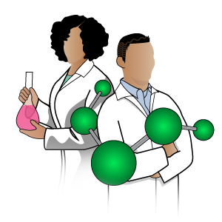

IRISH SCIENTISTS
Aoife McDonnell

Slide 2
‘Someone is sitting in the shade today because someone planted a tree a long time ago’
– Warren Buffet

Slide 3
LEARNING INTENTIONS:
Worksheet 1
Identify 10 – 20 Irish Scientists and create a timeline of their contributions.
Research the contribution and life of a famous Irish scientist.
Career Investigation into a STEM career path.
Worksheet 2
Worksheet 3

Slide 4
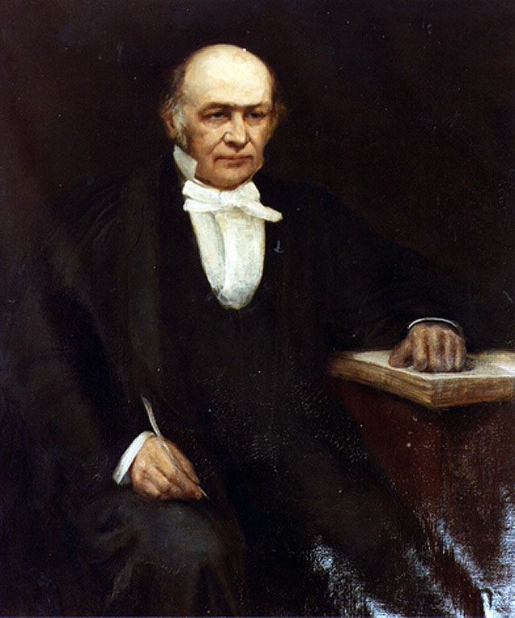
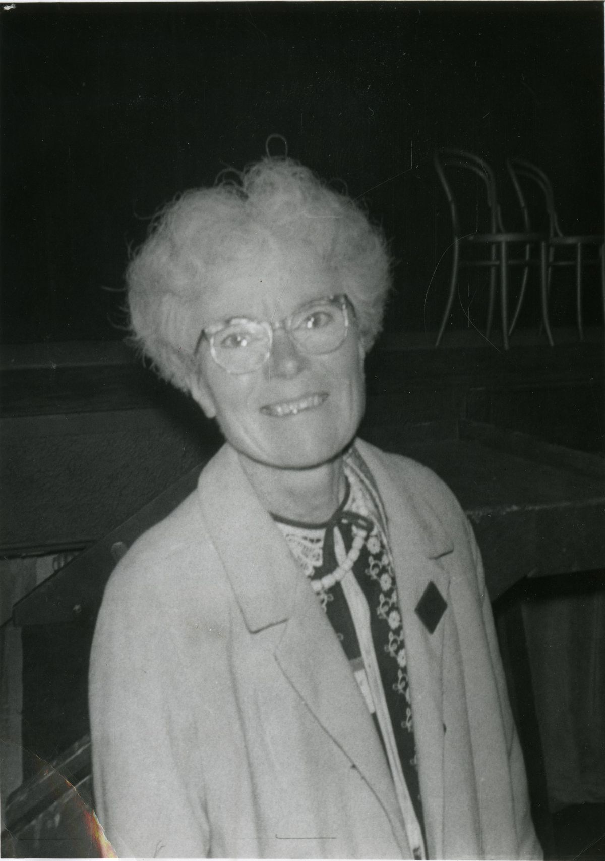
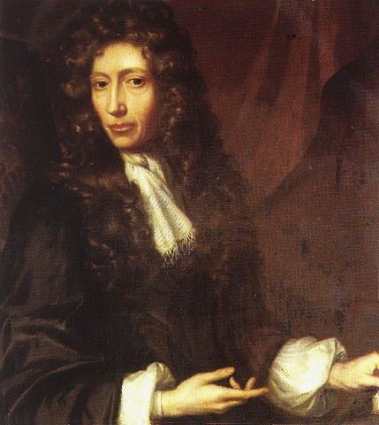
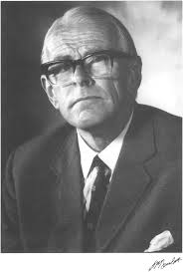
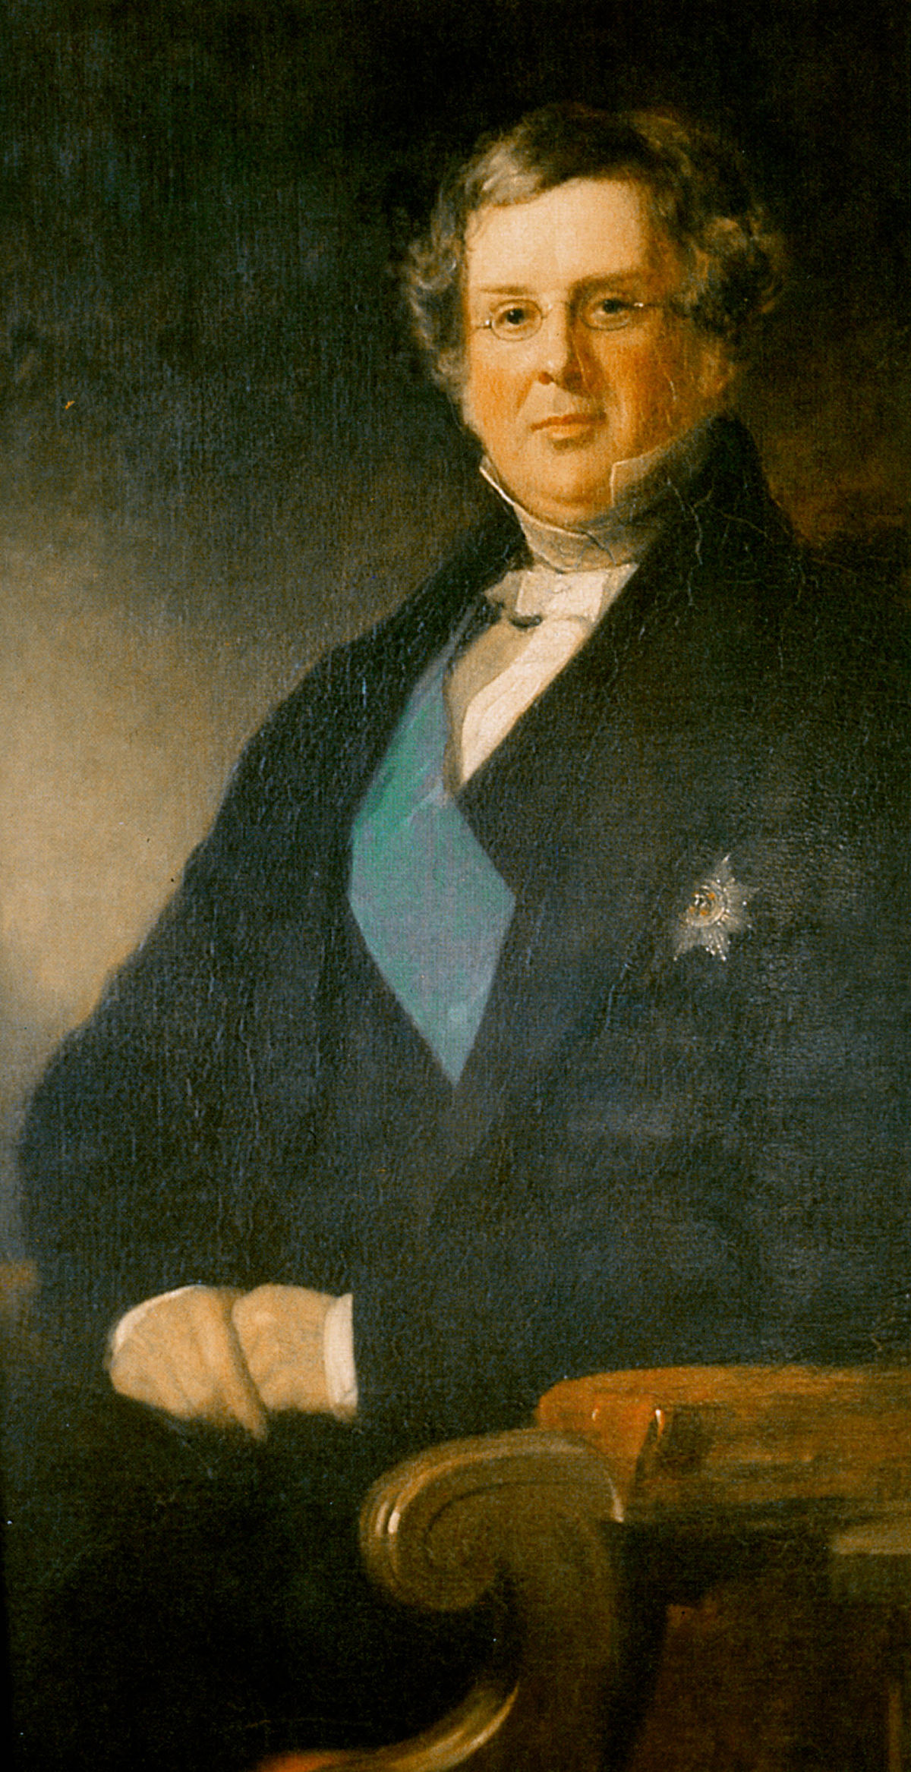

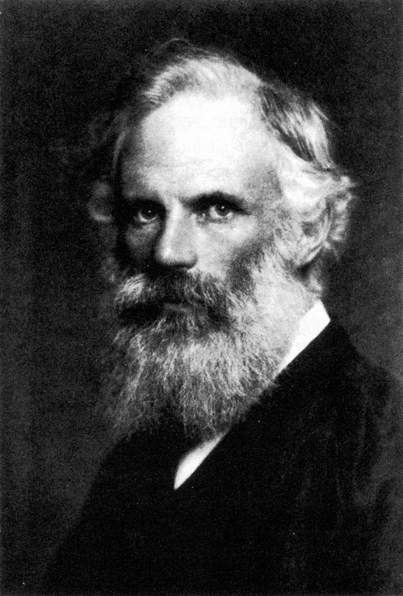
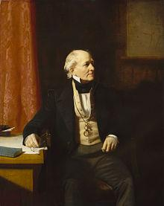
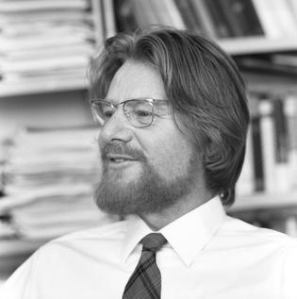
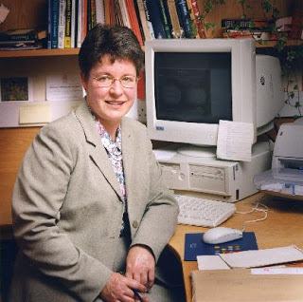
NAME THE IRISH SCIENTISTS:
Worksheet 1
Research the history and name of Irish Scientists…From your research, can you put a name to these faces???

Slide 5
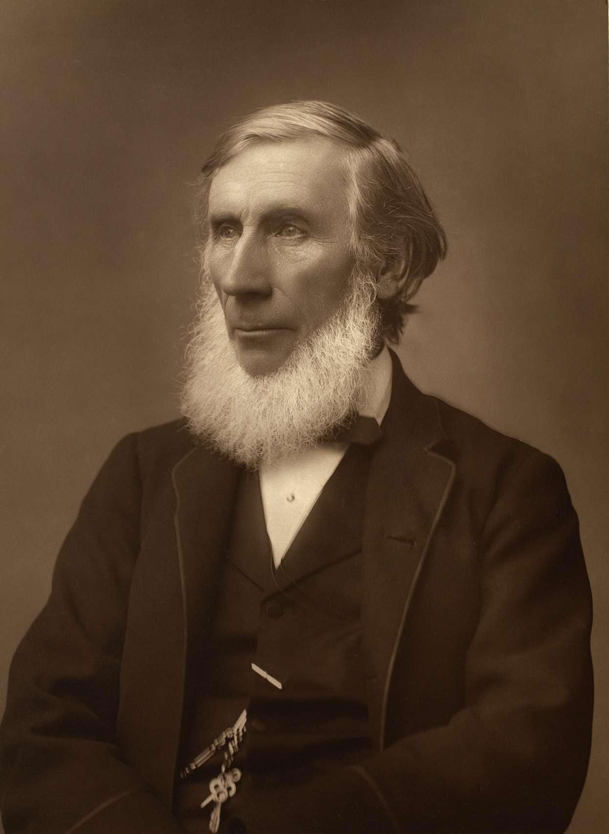
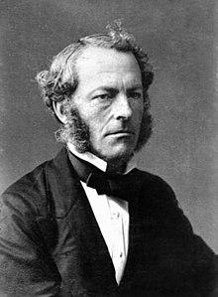
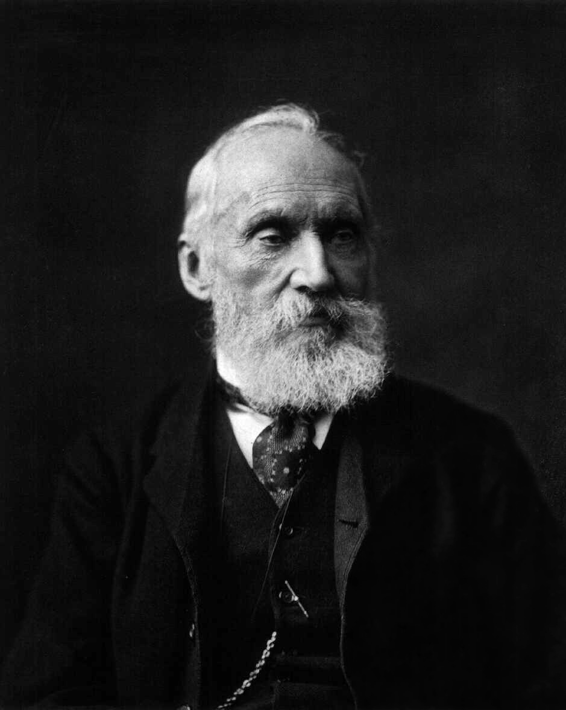
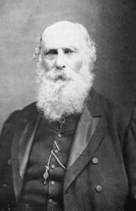
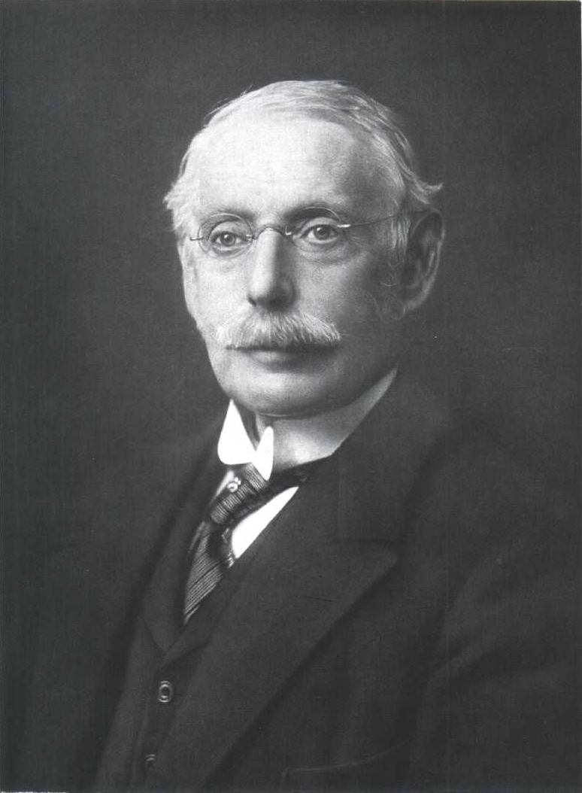
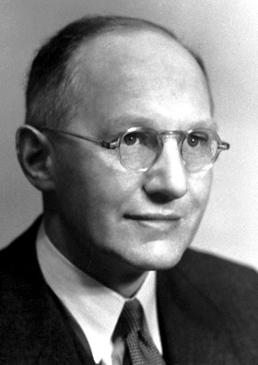
MORE…

Slide 6
SOLUTIONS:
Meet the Scientists…
William Rowan Hamiliton
Denis Parsons Burkitt
Kathleen Lonsdale
Robert Boyle
William Parsons
1805 - 1865
1903 - 1971
1627 - 1691
1911 - 1993
1800 - 1867

Slide 7
SOLUTIONS:
Meet the Scientists
Rev.
Nicholas Callan
George Francis FitzGerald
Jocelyn Bell Burnell
Francis Beaufort
John
Bell
1799 - 1864
1851 - 1901
1774 - 1857
1928 - 1990
1943 -

Slide 8
SOLUTIONS
Meet the Scientists
John Tyndall
George Gabriel Stokes
William Thomson
George Johnston Stoney
Charles Parson
1820 - 1893
1819 - 1903
1824 - 1907
1826 - 1911
1854 - 1931

Slide 9
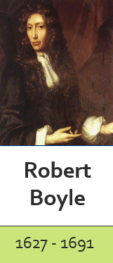
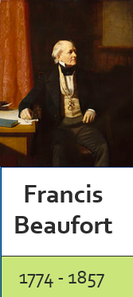
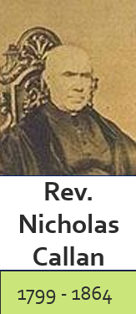
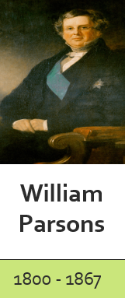
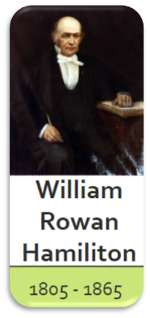
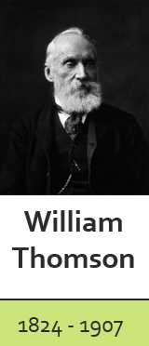
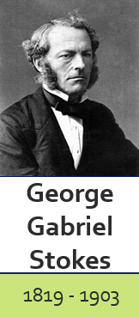
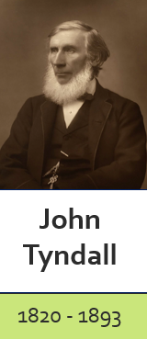
PLACE THE SCIENTISTS IN CHRONOLOGICAL ORDER
Students could use a string/ thread to connect the timeline together…

Slide 10
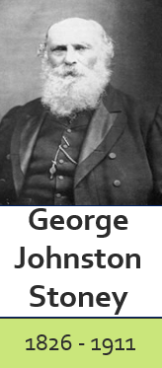
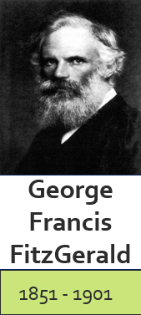
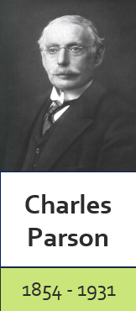
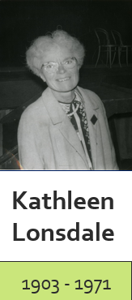
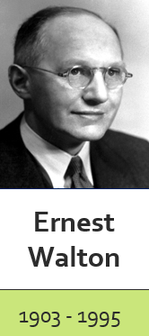
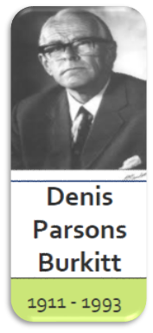
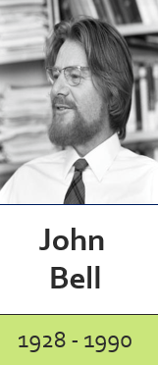
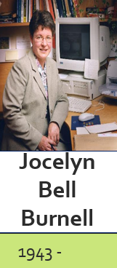
PLACE THE SCIENTISTS IN CHRONOLOGICAL ORDER
Students could use a string/ thread to connect the timeline together…

Slide 11
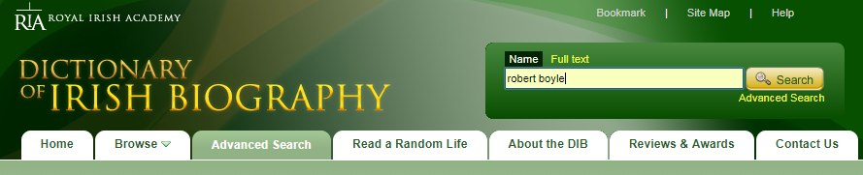
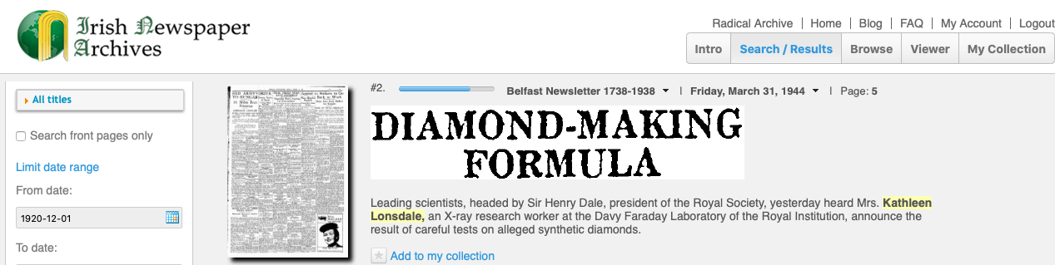
RESEARCH THE CONTRIBUTION OF SCIENTISTS
Pick from a hat or choose…but ensure all the scientists are covered within your group.
*Note - This is a classroom activity. The Dictionary of Irish Biography is available in schools. It’s available to all from Spring 20201

Slide 12
Documenting your Research
Worksheet 2
Record group research in the following format...
Scientist | Location Born | Contribution/ Achievement
Robert Boyle (Father of Chemistry) | Waterford | Boyle’s law - at constant temperature, the volume of a gas is inversely proportional to its pressure applied to the gas. Defined an element. Founder of the Royal Society of London.
Francis Beaufort | Navan, Co.Meath | Devised the Beaufort Scale in 1806. Helped Charles Darwin collect data for the theory of evolution.
Rev. Nicholas Callan | Ardee, Co. Louth | Invented the induction coil. Built the most powerful batteries and electromagnets of his time.
William Parsons | Birr, Co.Offaly | Built the largest telescope (Levithian of Parsonstown) that existed in 1845 at Birr Castle. It was the largest telescope for 75 years. This telescope made the first clear images of galaxies visible.
William Rowan Hamiliton | Dublin | Introduced the terms vector and scaler to algebra. Invented the Quaternions for multiplying vectors in 3-D space. Reformulated Newton’s laws.

Slide 13
Documenting your Research
Record group research in the following format...
Scientist | Location Born | Contribution/ Achievement
George Gabriel Strokes | Skreen, Co. Sligo | Established the science of hydrodynamics with his law of viscosity in 1851. Explained the formation of clouds in the atmosphere using equations. He described the phenomenon of fluorescence in 1852.
John Tyndall | Carlow | He was the first to explain how the scattering of light in the atmosphere causes the blue colour in the sky. He explained how the gases in the atmosphere trap heat and keep the earth warm - Greenhouse effect. He invented the light pipe.
William Thomson | Belfast | His name is enshrined in the Kelvin unit of temperature, effectively introduced by him in 1848 as the absolute thermometric scale. He shares credit for the concept of entropy. (Inventions – the air cooling by refrigeration)
George Johnston Stoney | Oakley Park, Co. Offaly. | Calculated the magnitude of the basic unit of electricity and named it the electron. He estimated the number of molecules in a cubic millimetre of gas at room temperature and pressure. He explained the absence of an atmosphere on the moon and of hydrogen in the earth's atmosphere
George Francis FitzGerald | Monkstown, Dublin | Mainly known for Lorentz–Fitzgerald contraction - the shortening of an object along the direction of its motion relative to an observer.

Slide 14
Documenting your Research
Record group research in the following format...
Scientist | Location Born | Contribution/ Achievement
Charles Parson | London (But son of William Parson, Offaly) | Invented the steam turbine.
Kathleen Lonsdale | Newbridge, Co. Kildare | She demonstrated, using x-ray crystallography, that benzene ring is flat. (Proved by X-ray diffraction of crystals of hexamethylbenzene.)
Ernest Walton | Dungarvan, Co. Waterford | Together with John Crockroft, he built the first successful particle accelerator. In 1932, he achieved the first successful transmutation of an atomic nucleus when they split the nucleus of the lithium atom and identified the products as helium nuclei.
Denis Parsons Burkitt | Enniskillen, Co. Fermanagh | The first to describe a lethal cancer commonly suffered by African children, which from 1963 was known as Burkitt's lymphoma. Wrote a paper on geographical distribution of disease. He made a major breakthrough in cancer treatment when he was able to cure the lymphoma by chemotherapy. He promoted the importance of dietary fibre as a constituent of a healthy diet and in the prevention of disease
John Bell | Belfast | Worked in the European Center for Nuclear Research. He Developed the set of equations called Bell’s Inequalities.
Jocelyn Bell Burnell | Belfast | Discovered pulsars - rapidly rotating neutron stars.

Slide 15
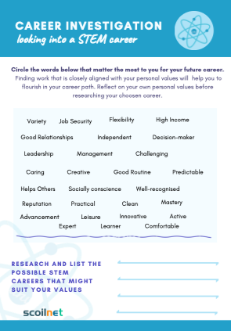
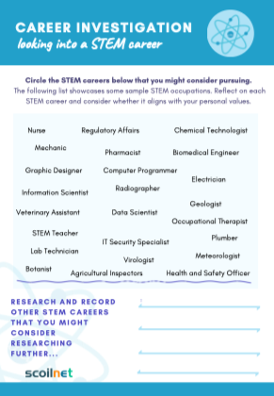
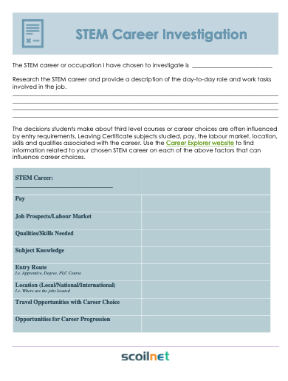
Careers involving Science
TY is a perfect time to research and discovery your career preferences and to make well informed decisions on your Leaving Certificate subject choices in order to align them with your future courses of study and career preferences.
Notes:
It is important that your chosen career is well suited to your interests, values, skills and personality. TY is a perfect time to research and discovery your career preferences and to make well informed decisions on your Leaving Certificate subject choices in order to align them with your career preferences. https://www.scoilnet.ie/learning-path/ref/3783/

Slide 16
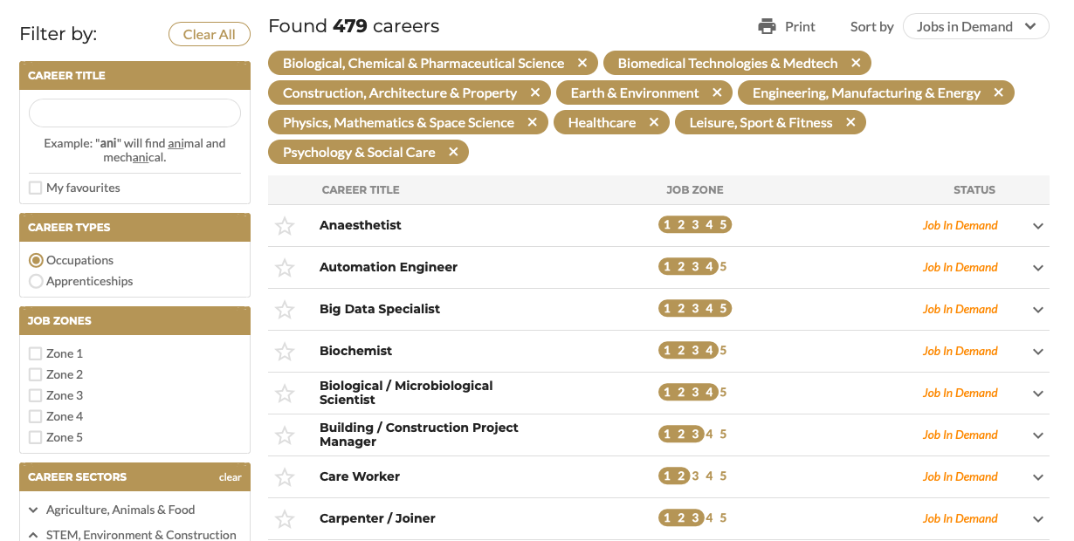

Slide 17
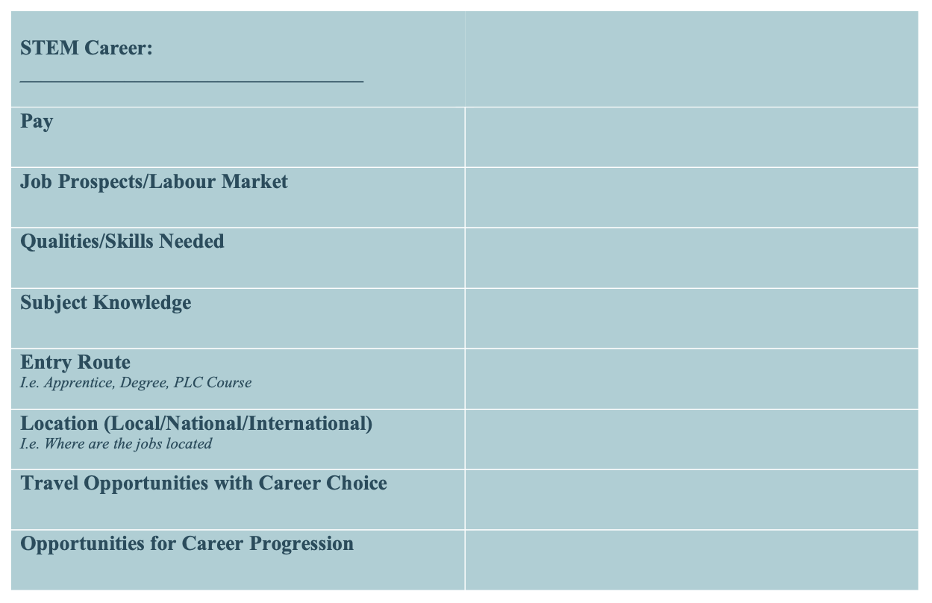

Slide 18


Slide 19
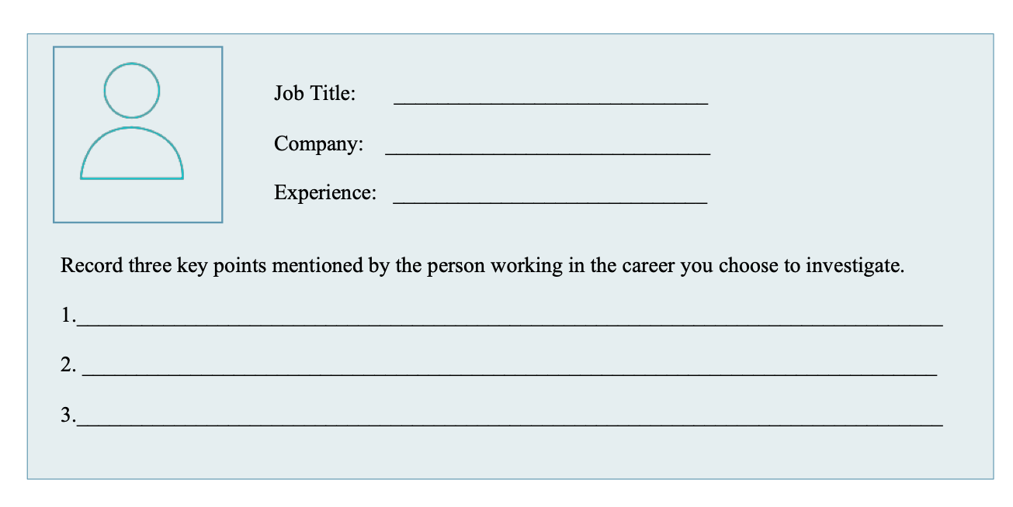

Slide 20
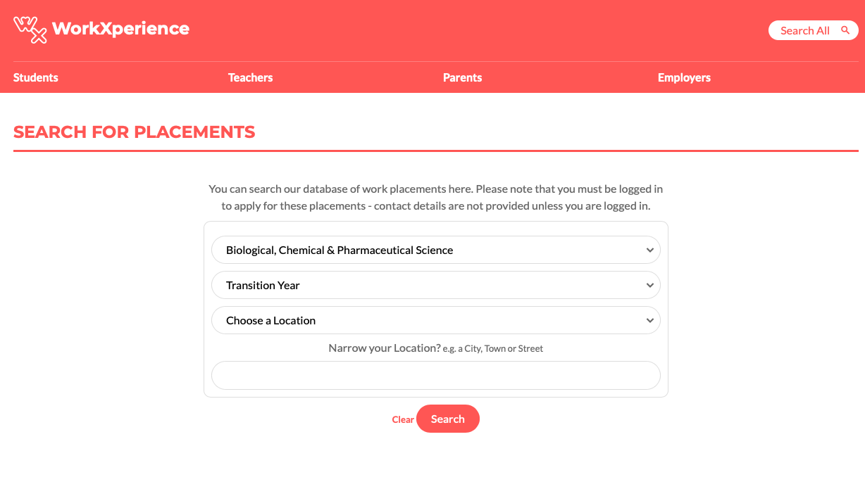

Slide 21
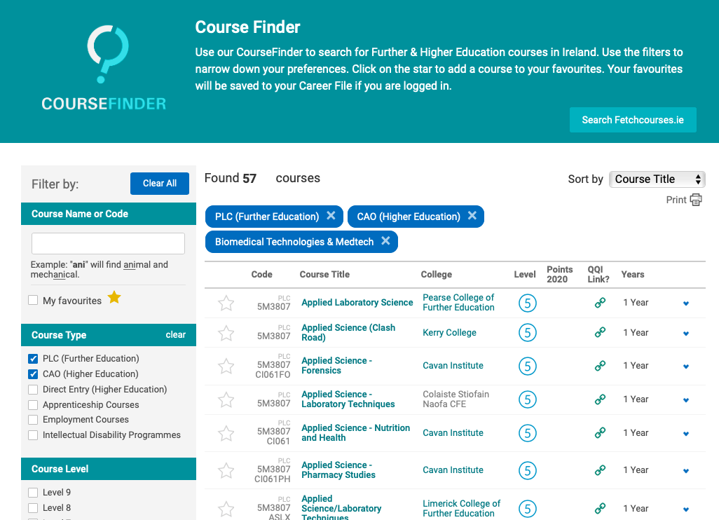

Slide 22
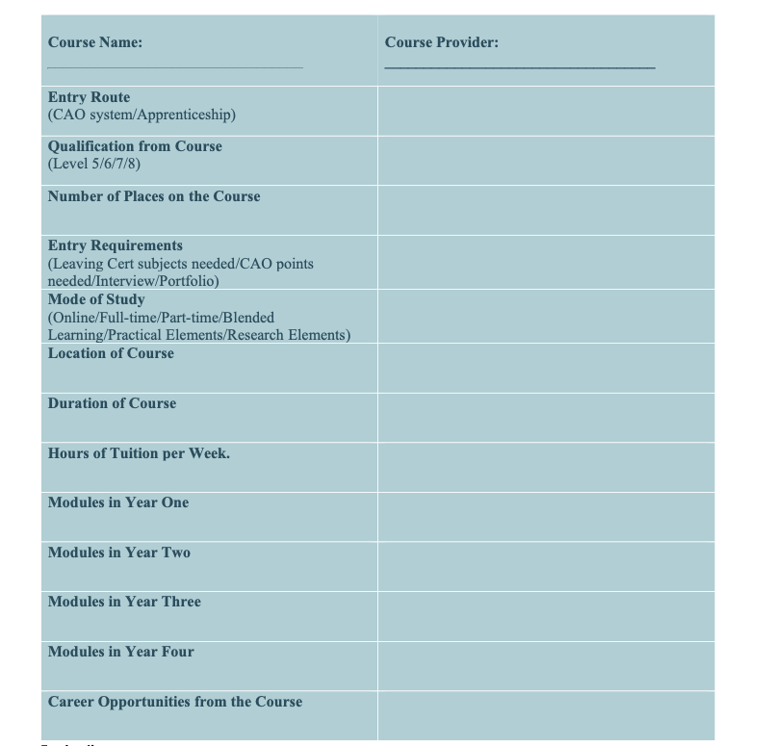

Slide 23

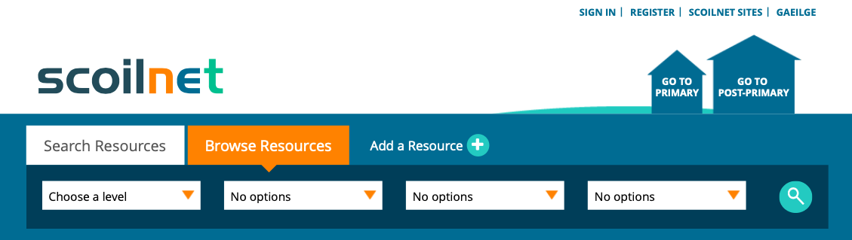




Aoife McDonnell
Lesson and Supporting Material Available at www.scoilnet.ie/IrishScientists
Email: scoilnetpdst@gmail.com
Twitter: @ScoilnetPPrim

