Slide 1
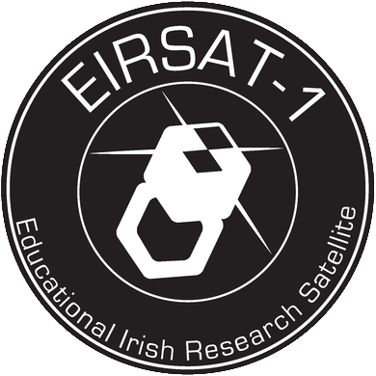
Step 1a
Fundamentals of Radio Communication
Notes:
Page 1-5 support document

Slide 2

Educational Irish Research Satellite
(EIRSAT-1)
https://www.eirsat1.ie/
EIRSAT-1 is supported by the ESA Education Office under its ‘Fly Your Satellite!’ programme
https://www.esa.int/Education

Slide 3
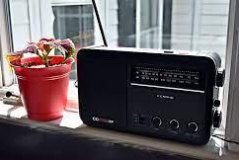
The Importance of Radio in Society
What do you understand by the word radio?
…a device we listen to at home in the kitchen?
…what the driver of a car or bus sings along to…
A radio entertains us with music and chat in real-time.
It is a reliable source of news, providing us with up-to-date information.
It can be a companion for those who live alone connecting the listener to the world.
The radio is more than just what you listen to at home. It is more than the radio presenters, the news and the music we listen to…
Can you think of other uses of radio in the world?
What words do you associate with radio?
Notes:
https://live.staticflickr.com/1892/30562252258_df81529cca_b.jpg

Slide 4
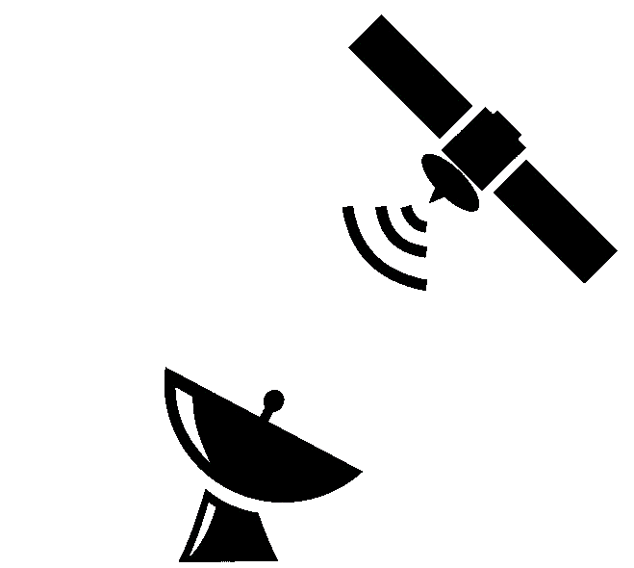
Satellites
Satellites are objects that orbit the earth.
The moon is a natural satellite but there are also artificial satellites!
Two examples of artificial satellites:
1. Communication
2. Weather forecasting
Notes:
https://www.nasa.gov/audience/forstudents/5-8/features/nasa-knows/what-is-a-satellite-58.html
https://www.met.ie/education/satellite-images-of-ireland

Slide 5
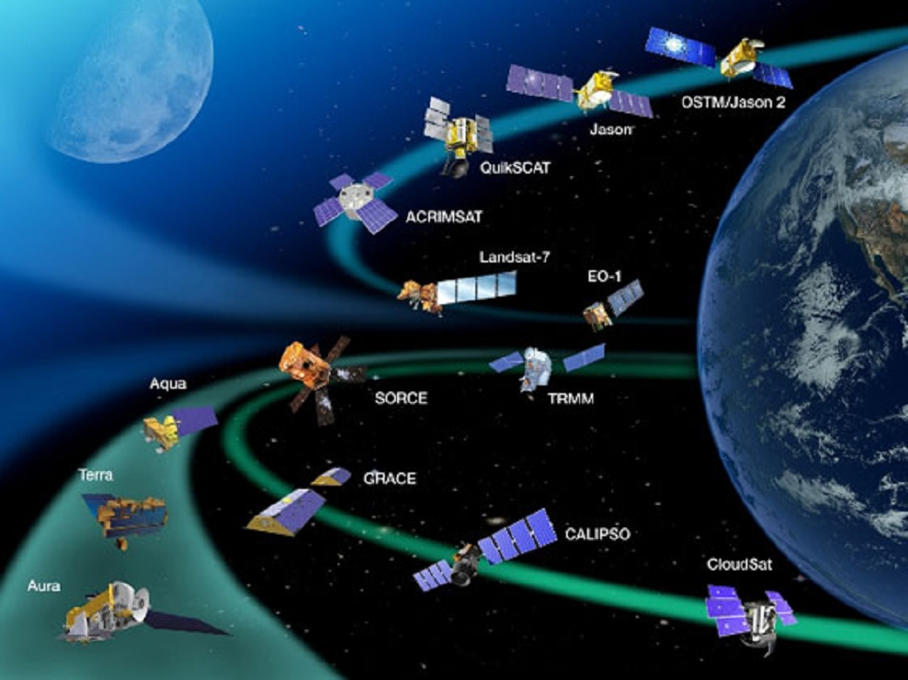
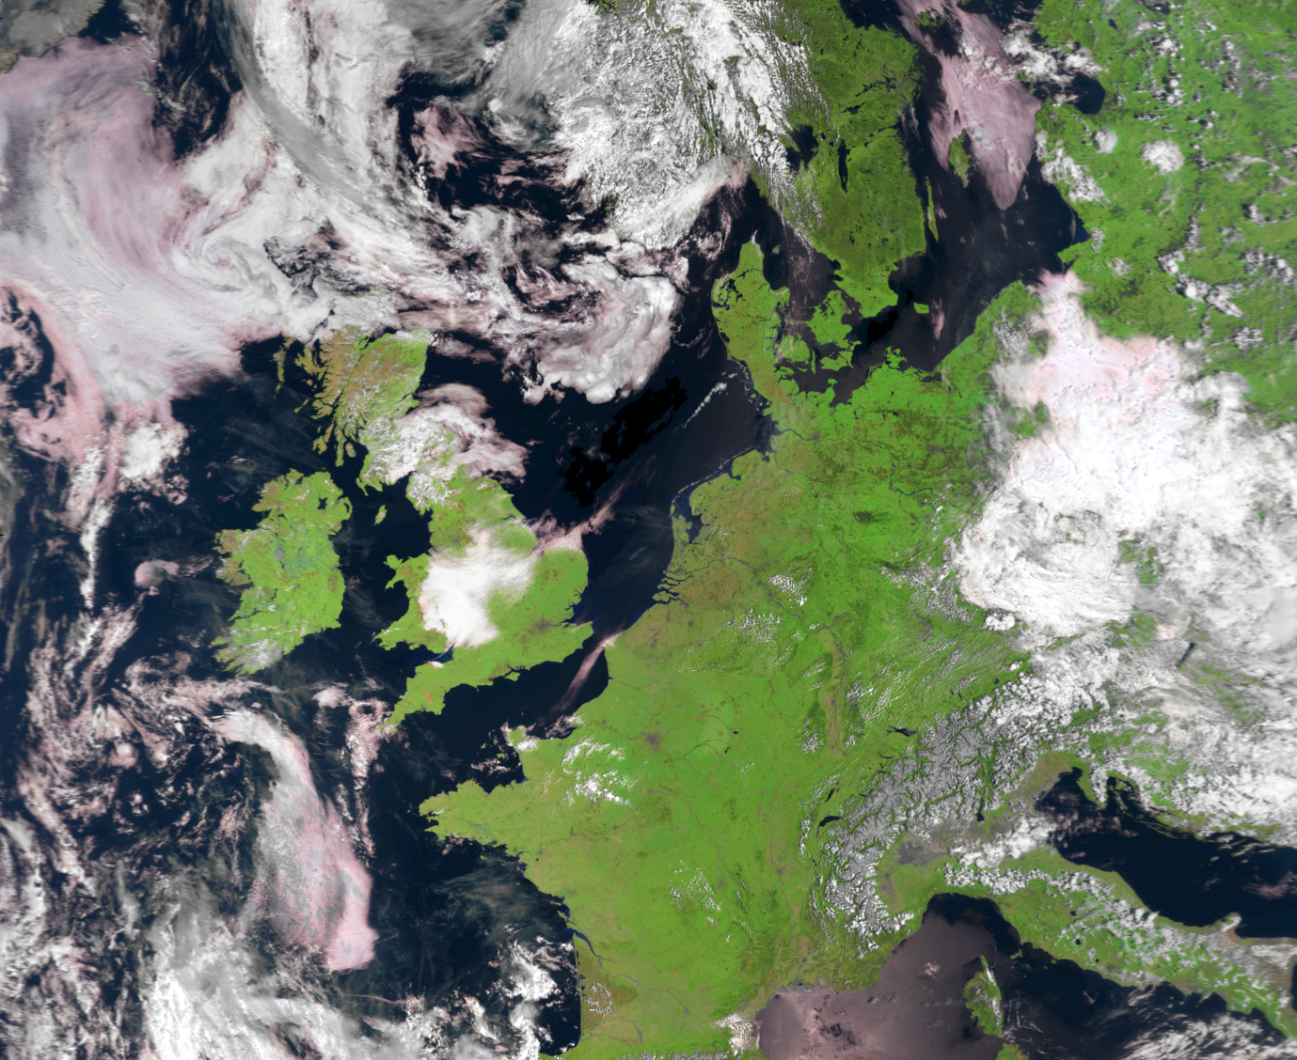


Satellite Communication and Weather Forecasting
https://www.nasa.gov/audience/forstudents/5-8/features/nasa-knows/what-is-a-satellite-58.html
https://www.met.ie/education/satellite-images-of-ireland
How do these satellites communicate with us?
How are the weather images beamed back to earth?
…Radio signals!!
Notes:
https://www.nasa.gov/audience/forstudents/5-8/features/nasa-knows/what-is-a-satellite-58.html
https://www.met.ie/education/satellite-images-of-ireland

Slide 6
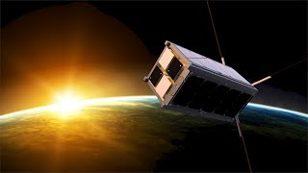
Satellite Communication
Did you know:
Ireland will soon launch it’s very first satellite EIRSAT-1. EIRSAT-1 stands for the Educational Irish Research Satellite 1. It is a satellite about the size of a shoe box, called a CubeSat
Learn how students built Ireland’s first satellite https://www.youtube.com/watch?v=mTrfaTchBWk ow students built Ireland's first satellite - YouTube
Notes:
https://www.youtube.com/watch?v=oEF4EY6SP8E
Did you know: Ireland will soon launch it’s very first satellite EIRSAT-1. EIRSAT-1 stands for the Educational Irish Research Satellite 1. It is a satellite about the size of a shoe box, called a CubeSat. It is a small scale satellite but still needs the same functionality as a large mission. The satellite must be able to power itself, orientate itself in space, communicate to the ground station being built on the roof of the UCD School of Physics and collect data from the three science experiments on-board.

Slide 7
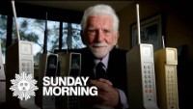
The Father of the Cell Phone
https://youtu.be/bodPO9PWwcI

Slide 8
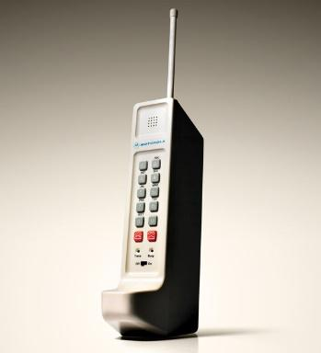
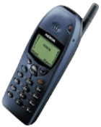
Mobile Phones
Did you know that the first mobile phones were actually radios?
They were two-way radios which means you could talk and listen. They allowed taxi drivers and emergency crew to communicate.
Phones used to have an antenna that you could see. Although your smart phone is packed full of the latest technology, it still uses radio waves to communicate to the world (cell towers, WiFi nodes etc.).
Modern phones have at least four antennas. It should be called a “smart radio”!!
Did you know:
Motorola was the first company to mass produce the first handheld mobile phone. These early phones were called OG or ZERO Generation
Nokia 6110, released in 1998
https://www.firstversions.com/2015/01/motorola.html

Slide 9
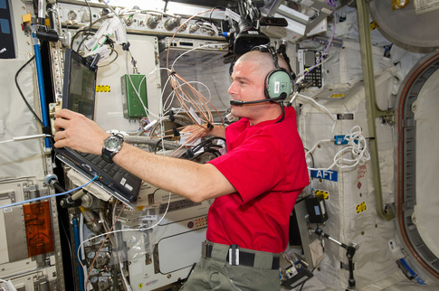
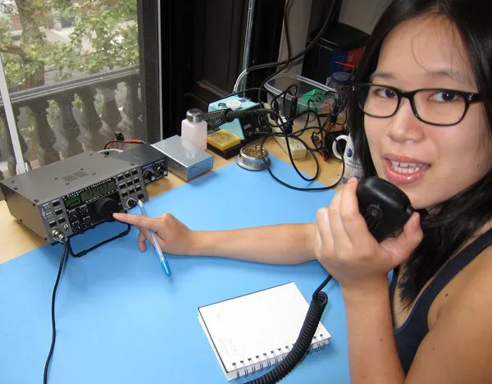
Radio as a Hobby
Before the days of mobile phones and the internet, people relied on the radio to communicate with each other.
Today, Amateur radio (also known as HAM radio) is a popular fun and educational hobby worldwide.
People use HAM radio to talk to people all over the world – all without using mobile phones or the internet! They can even talk to astronauts on board the International Space Station (ISS).
Amateur radio operators come from all walks of life …and... all ages!
https://www.ariss.org/contact-the-iss.html
Diana Eng, HAM radio enthusiast
https://makezine.com/article/technology/5-ham-radio-projects-with-diana-eng/

Slide 10
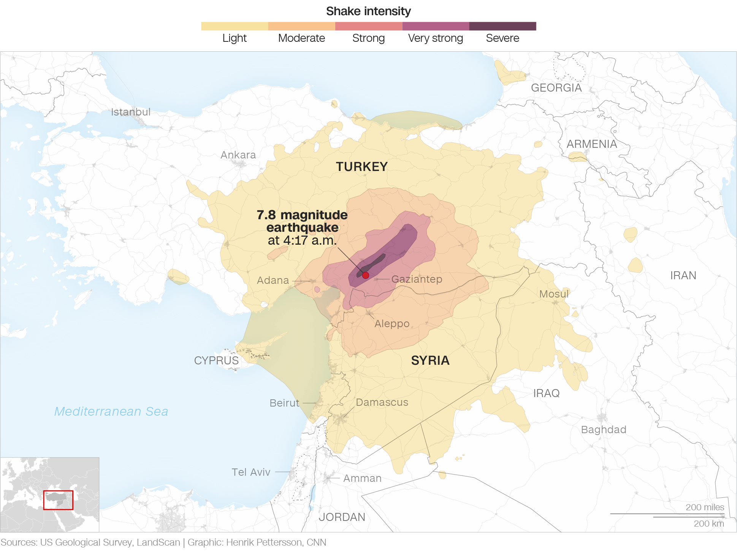

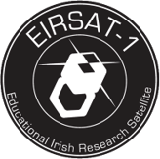
Amateur Radio and the Real World
During the 2023 devastating earthquake in Turkey and Syria, many Radio Amateurs were brought in to help the emergency response teams.
Did you know:
Radio hobbyists from South Dublin Radio Club provided advice to the EIRSAT-1 team, Ireland’s first satellite
https://www.iaru-r1.org/2023/turkiye-earthquake-6-february-2023/
Notes:
https://www.ariss.org/contact-the-iss.htm

Slide 11

Radio in Business
Radio is also important in society for advertising
For more information visit:
https://www.radiocentreireland.ie/

Slide 12

What’s next?
Would you like to learn more about Radio Waves?
Continue to the Step 1b Radio Waves

